Slide 1


Slide 2
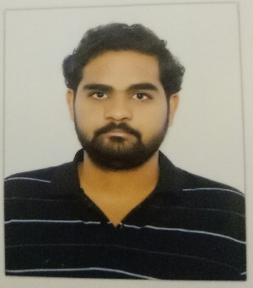
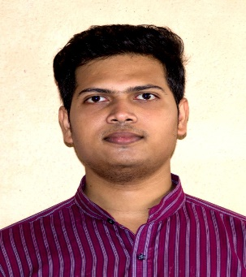
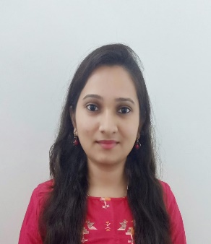
Project Highlights
Project Name : Web Development: Get,Set,Blog…!: Simple Blogging Website
Team Size : 3
BU Mentor Name : Mentor PS#
R Sriniketan
99002487
2009MYSSPSB1
B.Tech CSE
HTML, JavaScript, C, C++
SK MD Sohel
99002492
2009MYSSPSB1
M.Tech CSE
C, C++, Java, Python
Vidyashree C V
99002492
2009MYSSPSB1
B.E CSE
C, Java, HTML, CSS

Slide 3
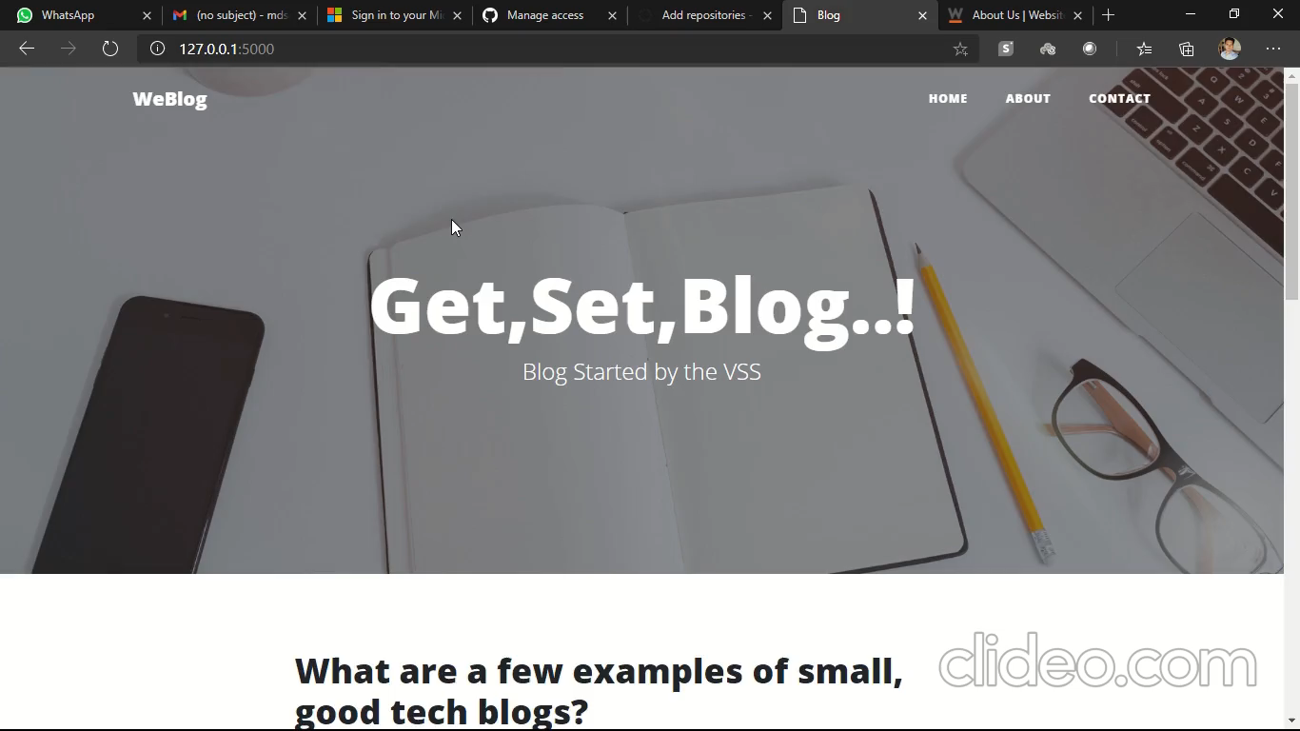
Project Video Snippet

Slide 4
Future development that can be implemented further
Adding a Registration and Login page for the users.
Enhancement in User Interface and User experience.

Slide 5


Thank You !

